Slide 1

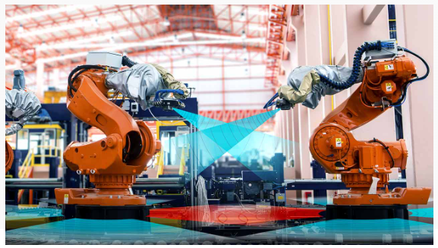

CSC485B Machine Learning for Robotics
SUNY Plattsburgh
Dr. Ned Lecky
Class 25: Embedded Machine Learning

Slide 2
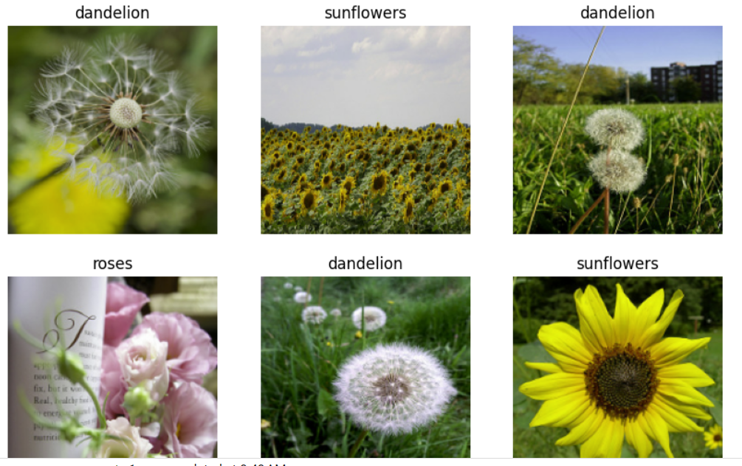
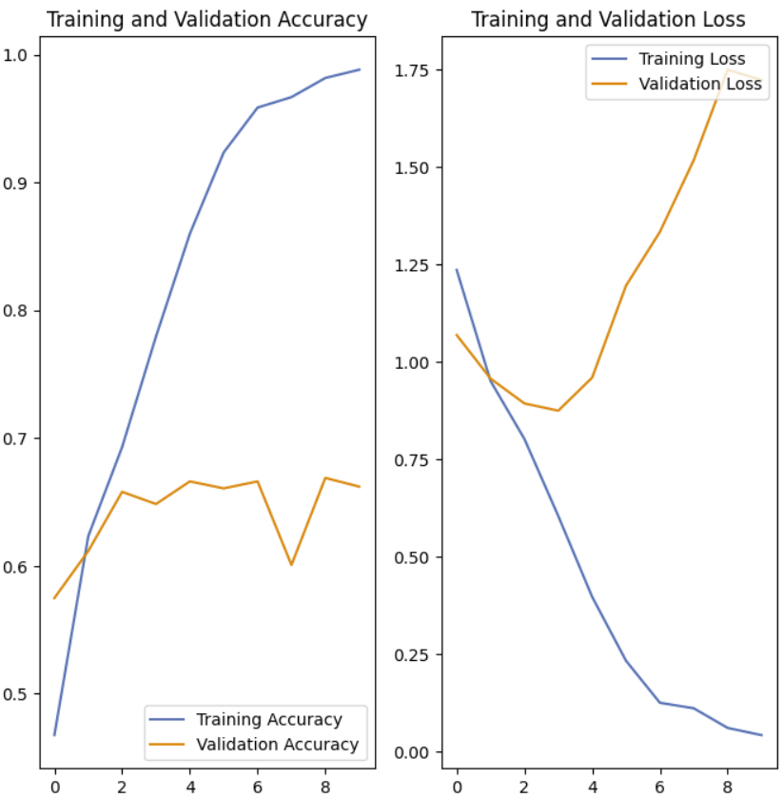
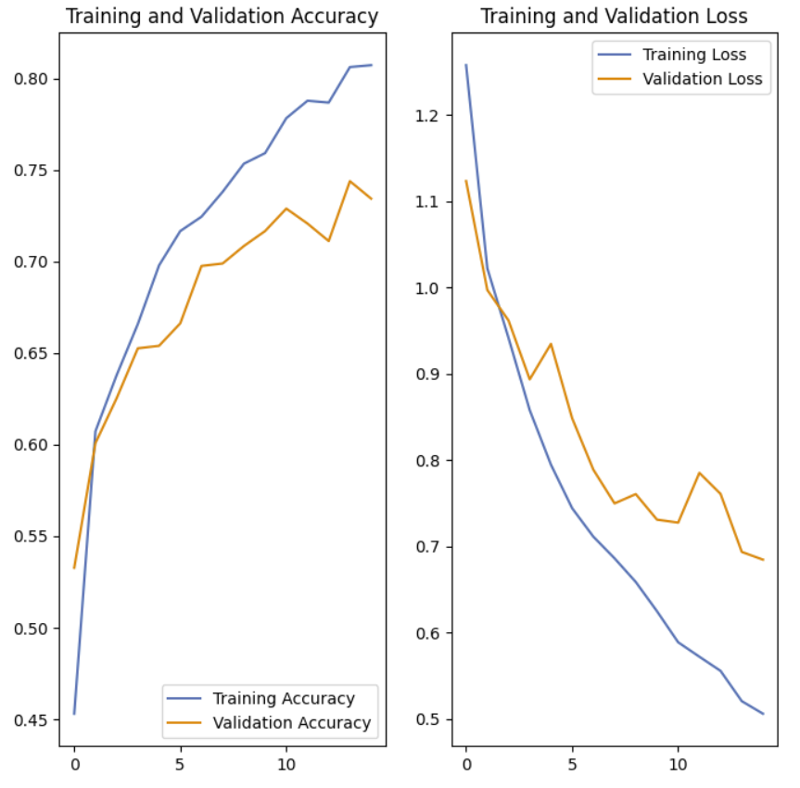
One More Thing on Keras Image Classification
This example from last time…
https://www.tensorflow.org/tutorials/images/classification
Ends with something very interestingTensorFlowLite

Slide 3
TensorFlow Lite
This example also shows how to take your trained model and run it on small devices
# Convert the model.
converter = tf.lite.TFLiteConverter.from_keras_model(model)
tflite_model = converter.convert()
# Save the model.
with open('model.tflite', 'wb') as f:
f.write(tflite_model)

Slide 4
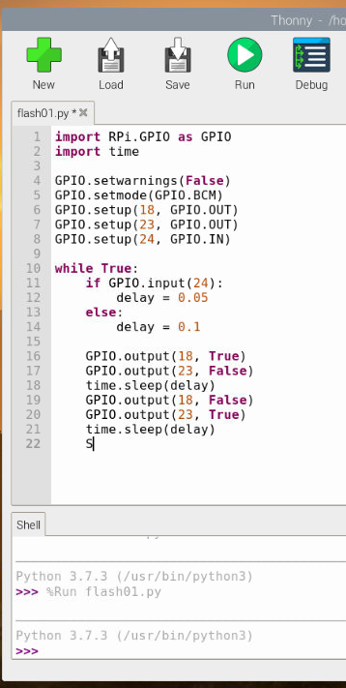
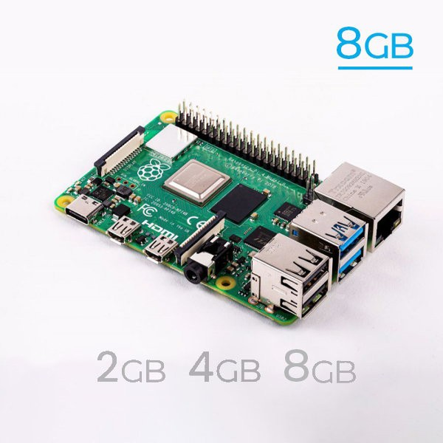
PyTorch for Raspberry Pi
Another embedded possibility
https://pytorch.org/tutorials/intermediate/realtime_rpi.html

Slide 5
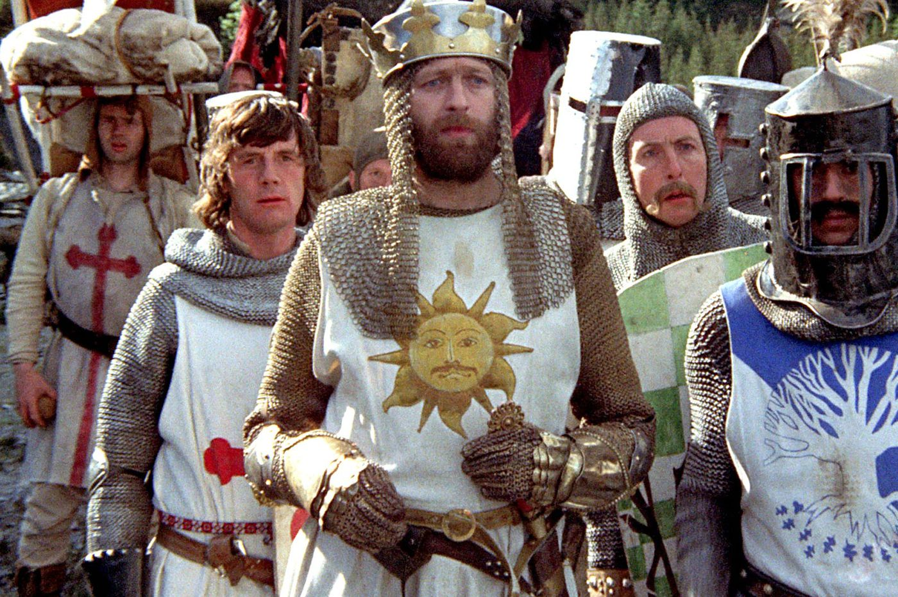
But Python?
PyTorch and TF Lite rely on Python and some sort of Operating System underneath it
Raspberry Pi is sort of like minimum viable system for that
NUC is also a good option
What if we’re running on something really small? Can we still do ML?

Slide 6
Minimal Neural Network
Here’s a great minimalist implementation in C
https://towardsdatascience.com/simple-neural-network-implementation-in-c-663f51447547
Many of the cool ideas we learned for DL could be easily tacked onto this example
Virtually any small controller has at least a C compiler!
Here’s another hammer-and-tongs neural network implementation
https://medium.com/analytics-vidhya/building-neural-network-framework-in-c-using-backpropagation-8ad589a0752d

Slide 7
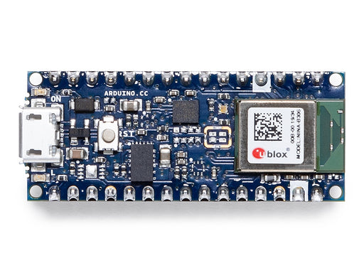
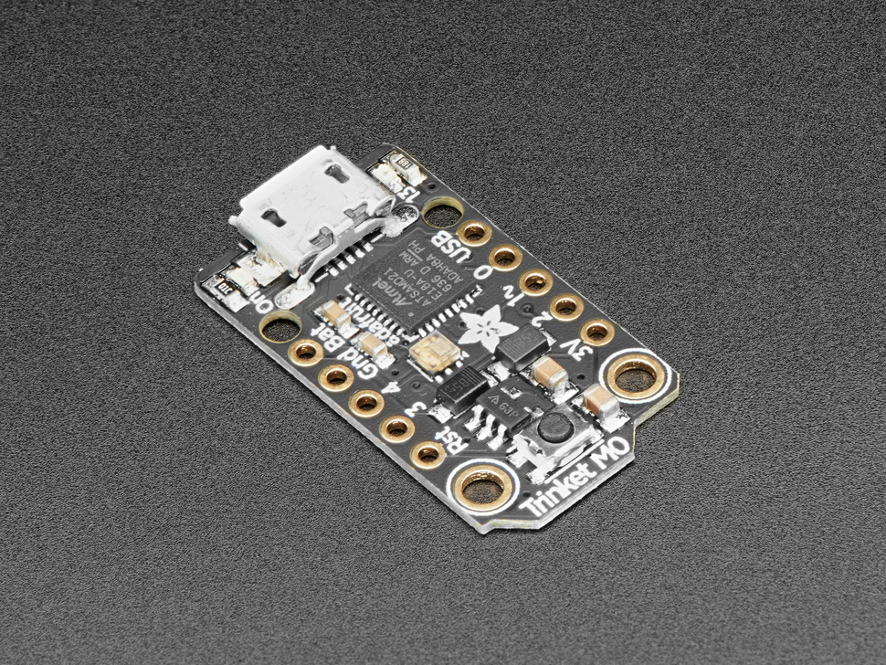
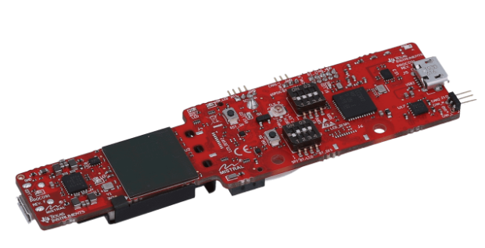
Really small systems
Very small systems
Arduino
https://en.wikipedia.org/wiki/Arduino
Roll Your Own
My client’s radar sensor
https://www.ti.com/product/AWR6843AOP

Slide 8
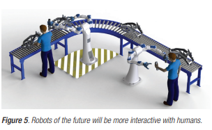
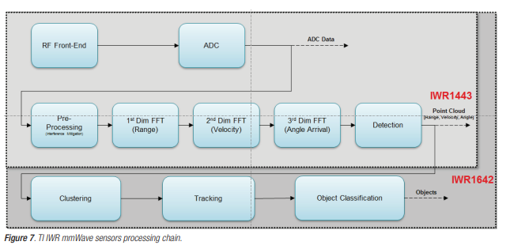
What Can We Learn
mmWave radar sensors in robotics applications
https://www.ti.com/lit/wp/spry311a/spry311a.pdf?ts=1683039499310&ref_url=https%253A%252F%252Fwww.ti.com%252Fproduct%252FAWR6843AOP

Slide 9
New Ideas
Next Gen
https://www.ti.com/sensors/mmwave-radar/industrial/overview.html

Slide 10
Summary
Tons of opportunities to use ML in very small “edge” devices
Getting the code to work and run and have adequate performance is loads of work/fun!

